Slide 1

Project Quack
Presented by
The Bestagons
Notes:
Miles

Slide 2
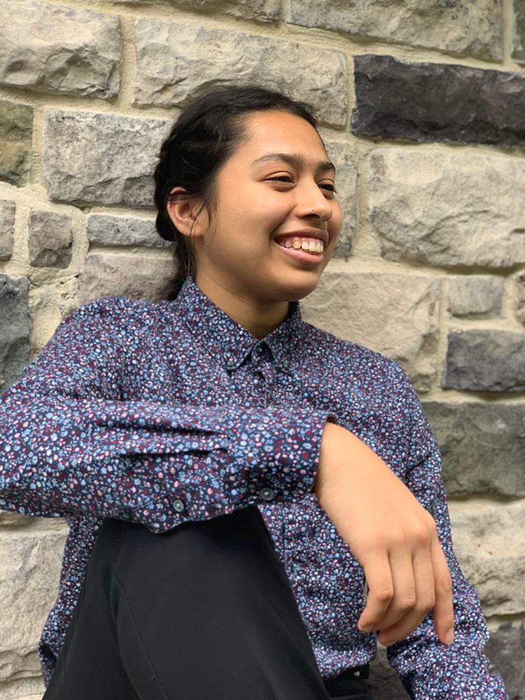
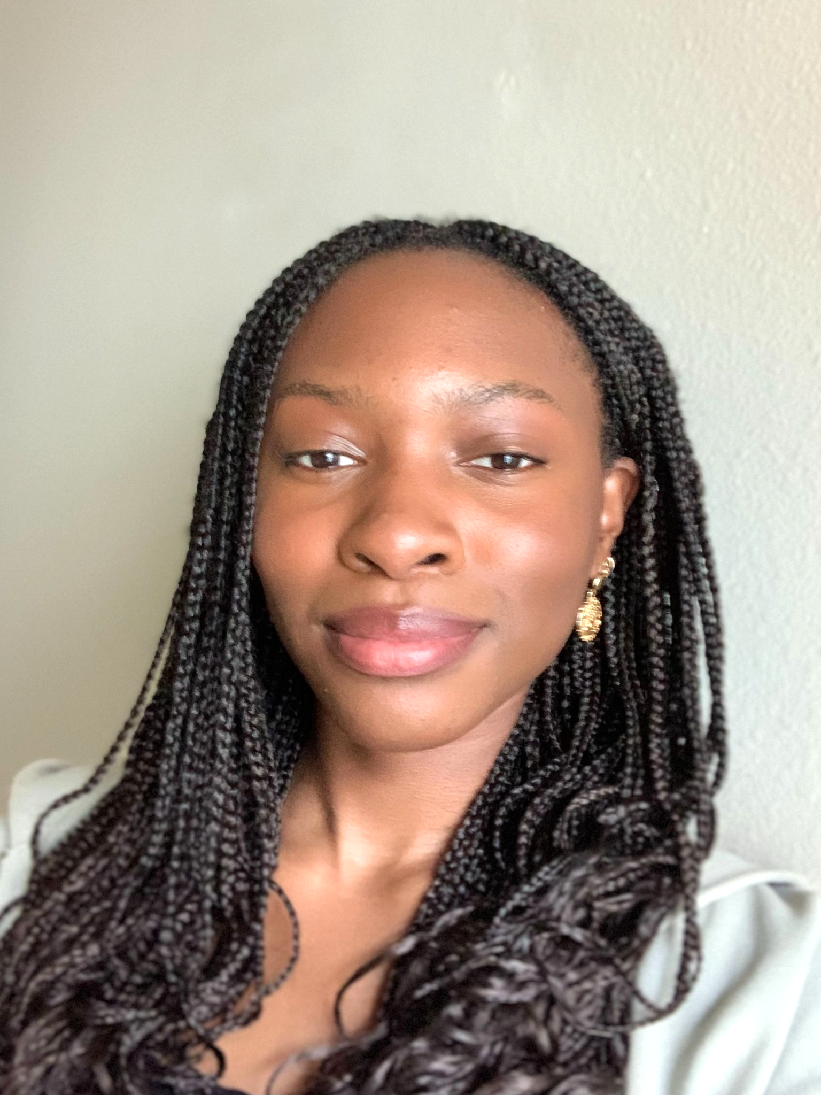
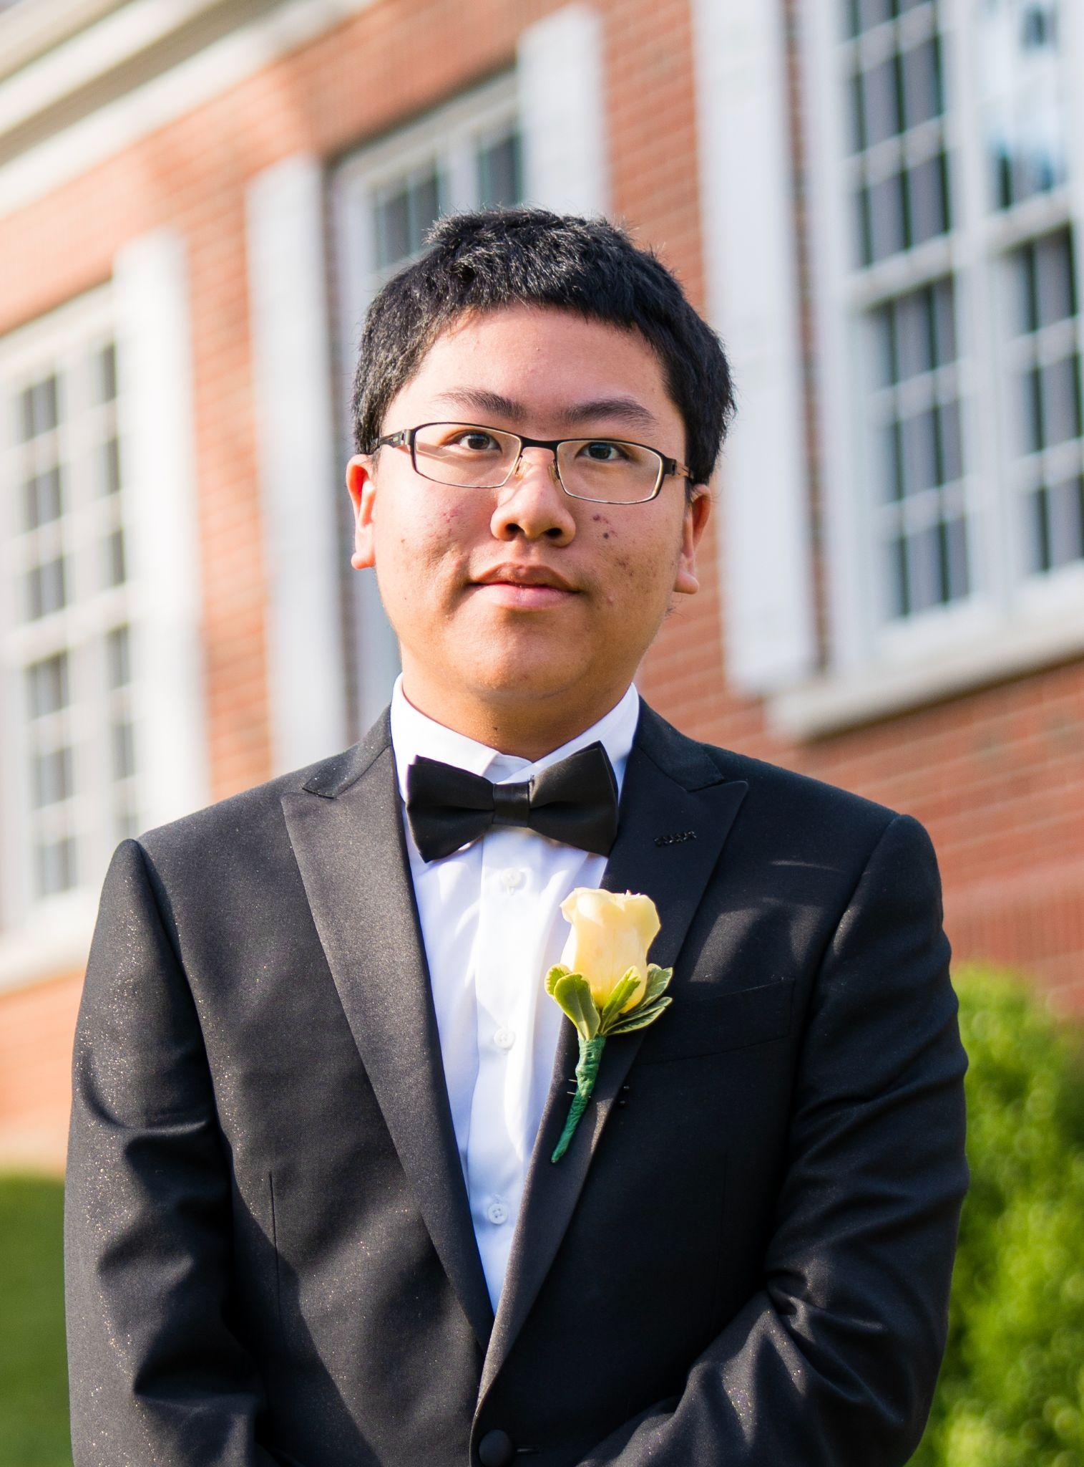
OUR TEAM
Mimi Olayeye
Brenda Cano
David Wei
Team Member
Team Member
Team member
Notes:
Mimi, Brenda, Davis

Slide 3
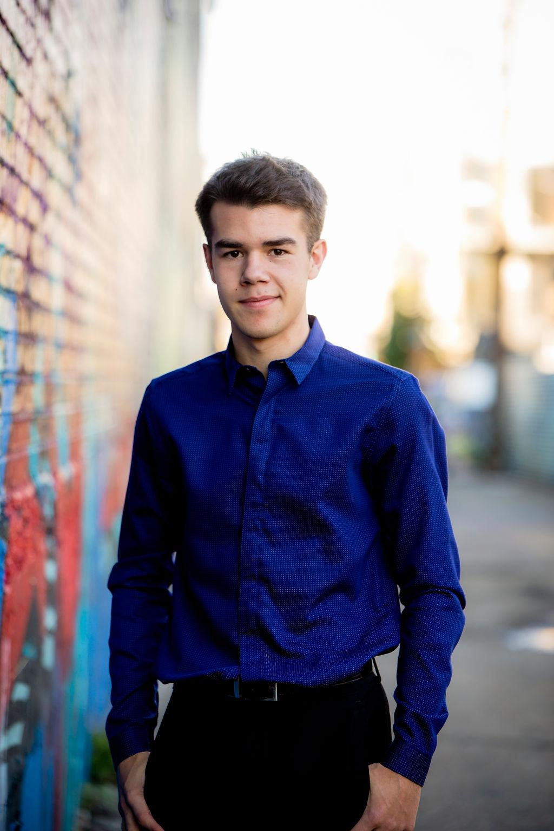


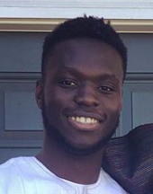
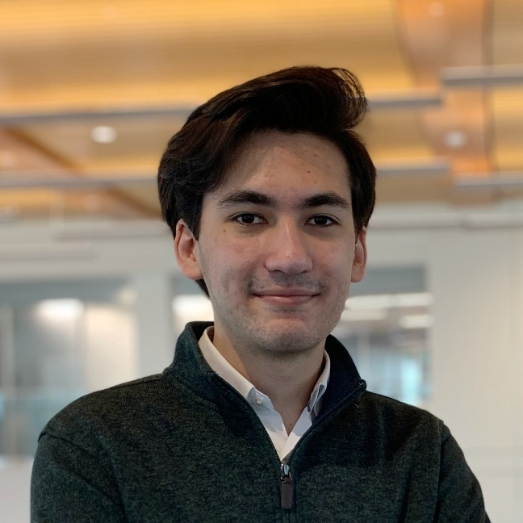
OUR TEAM
Ore Adenikinju
Miles Robertson
Rafael Piloto
Team member
Product Owner
Scrum Master
Notes:
Miles, Ore, Rafael

Slide 4
PROBLEM VS OUR SOLUTION (elevator pitch)
PROBLEM
SOLUTION
Returning from a pandemic, Emory University hasn’t quite figured out all the best systems yet. Coordinating a consistent student experience of classes and dining has yet to be achieved. Dining options are in flux and unclear.
An app that does all the thinking for you. Get notified when your favorite meals are served or when other friends are available to eat. Coordinate seating locations by viewing a heatmap of locations and see capacity statistics to beat rush hour and dine at the safest time.
Notes:
Mimi

Slide 5
AGENDA
01
03
02
What did we accomplish?
What are our goals for the week?
Acknowledging feedback
Notes:
Mimi

Slide 6
01
What did we accomplish?
Notes:
Rafael

Slide 7
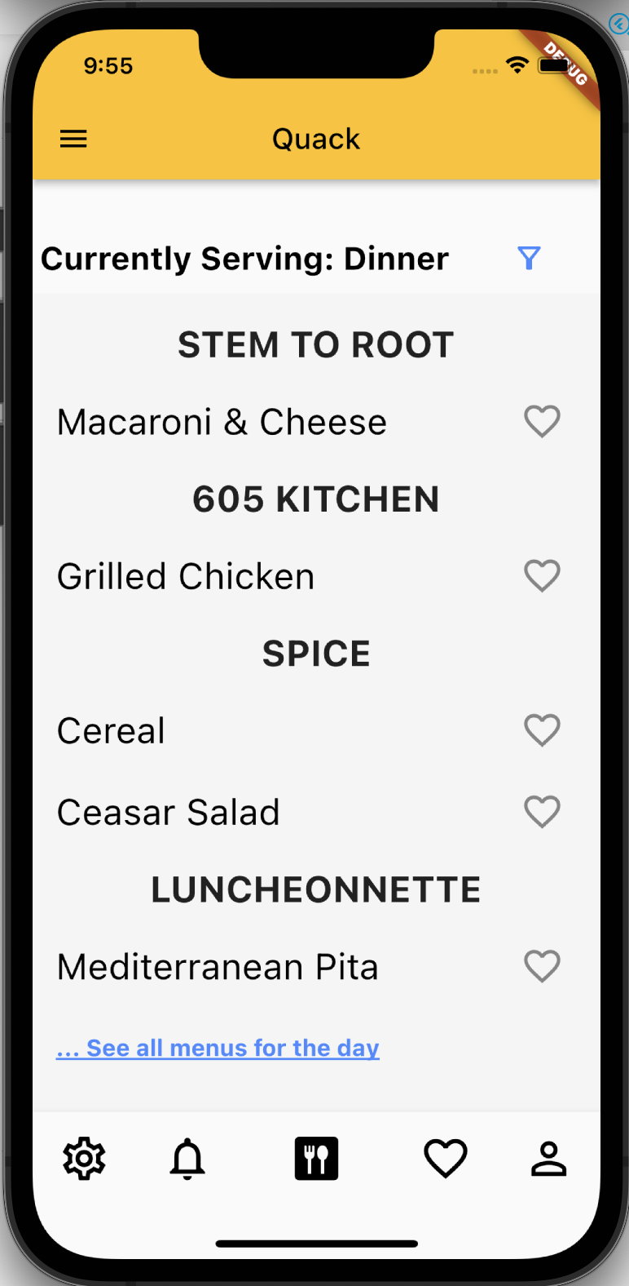
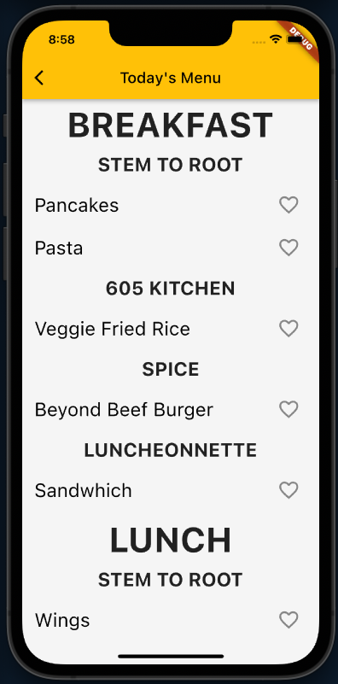
Today’s Menu
Notes:
Rafael

Slide 8
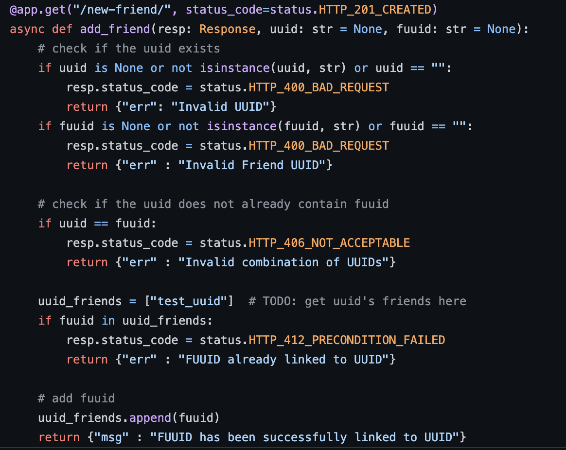
App Backend
Add New Friends
Notes:
Rafael

Slide 9
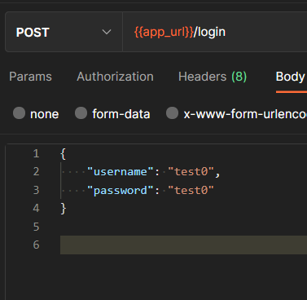
Login a User
Took time to understand how to create APIs and set up a simple post request for login that takes in a username and password.
Notes:
Brenda

Slide 10
Routing & Loading Screen
Created a loading screen which is displayed while data is fetched through the backend
Added/optimized routing between pages
Notes:
Ore

Slide 11
Code Refactoring & More
Created a reusable class representing food cell in a table
Clean up old code to make it look better suited for future use
Some backend explorations
Notes:
David

Slide 12
02
Acknowledging feedback
Notes:
Brenda

Slide 13
Features
Dooley/meal swipe tracker is too reliant on the user
Show pictures of food
Data
Too much mocked data
Future consideration of how to get data
Velocity*
What is our development velocity
Too much work on our hands?
*Velocity will be discussed in our goals for the week.
Notes:
Brenda

Slide 14
Features
Dooley/Meal swipe tracker
At the moment the user will have to update their dooley/meal swipe amount on the app
The app will help you budget
“You have 200 dooley left. You can use 5 dooley a day until November 22nd (end of semester)”
Pictures of food
We liked this feature idea and may take a crowdsource approach inspired by the Life@Emory team
Notes:
Miles

Slide 15
Data
Mocked data and how could they be implemented in real life
Heat map
Cameras set up in the DCT to detect frequency per location
DCT capacity
Working together with Emory they can allow us access to the real time data at swipe-ins
Estimated line times
Crowdsourcing: Google Maps style
Notes:
Ore

Slide 16
03
What are our goals for the week?
Notes:
Miles

Slide 17
4 points
ahead of schedule!
Notes:
Miles

Slide 18
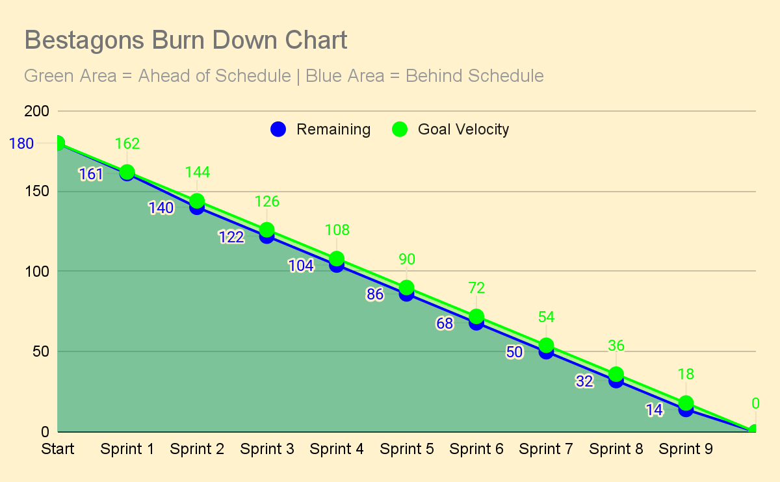
Notes:
Miles

Slide 19
Storytime: Further Development & Scrum Goals
[2pts] Save Seated Section
[1pts] Pair Coding
As a developer, I would like to have a helper method that saves the section a user sits in, so that this method can be reused.
This task will be complete when Ore and David have met to pair code for at least 30 minutes.
[2pts] Save Dooley Dollars
[1pts] Pair Coding
As a developer, I would like to be able to store dooley dollar balances, so that this helper method can be reused.
This task will be complete when Mimi and Brenda have met to pair code for at least 30 minutes.
[2pts] Save New <3
[1pts] Pair Coding
As a developer, I would like to have a helper method that saves new hearted items, so that the method can be reused.
This task will be complete when Rafael and Miles have met to pair code for at least 30 minutes.
Sprint 4 will be geared toward Backend Development & Pair Coding
Notes:
Miles

Slide 20
THANKS
Please remember to share your feedback :)
Notes:
Miles

